Slide 1

Very Basic Turing Machines
Notes, ICS 340

Slide 2
What a Turing Machine Is (I)
A Turing Machine (T.M.) is a model of a real computer.
Anything a computer can do, a T.M. can do.
A T.M. has a Control Unit (CPU)
It knows the transition function of the language (the program)
It has a read/write, semi-infinite tape (memory)
Think of each memory cell as a word starting from address 0.

Slide 3
What a T.M. Is (II)
A T.M. can read from and write to the tape.
The tape head can move left or right (but not stand still), one cell at a time.
The tape is semi-infinite, it has a left-hand end but goes off infinitely to the right.

Slide 4
A T.M. is a Stateful Machine
It is a stateful machine. The states include a single accept state and a single reject state, and if you hit either state you halt and accept/reject the input. (If you want to compute something, like for instance do math, you do the work, write it to a portion of the tape, and accept.)
You will run into other stateful machines in other courses
Finite State Machines
Pushdown Automata
If you have seen them, this will be a little easier.

Slide 5
Formal Definition
A Turing machine is a 7-tuple (Q, Σ, Γ, δ, q₀, q_{a}, q_{r}) where Q, Σ, Γ are finite sets and
Q is the set of states
Σ is the input alphabet not containing the blank symbol (think {0,1}, or 16-bit Unicode)
Γ is the tape alphabet, where ∈ Γ and Σ ⊂ Γ (in other words, a TM has not only 0 and 1 on its tape, but it can differentiate between used and unused memory).
δ: Q x Γ → Q x Γ x {L,R} is the transition function. (examples below…this is essentially the program)
q₀ ∈ Q is the start state
q_{a} ∈ Q is the accept state
q_{r} ∈ Q is the reject state

Slide 6
Execution
A T.M. always starts on the leftmost cell (think memory address 0) in state q₀.
At every step, the T.M. reads the tape cell underneath the tape head, writes the tape cell (possibly with the same thing it had before), and moves left or right.
If you’re at the left end of the tape and the transition says to move left, you stay at the left end of the tape.

Slide 7
Example
A setting of (state, tape contents, head location) is a configuration.
Suppose that we have the configuration of the first ten memory cells below.
The tape head (CPU) is at address 6, with contents G.
We can write this on one line as ABCDEFqGHIJ
Only works well for single-character memory contents
State |  |  |  |  |  |  | q
Mem | A | B | C | D | E | F | G | H | I | J
Addr | 0 | 1 | 2 | 3 | 4 | 5 | 6 | 7 | 8 | 9

Slide 8
Example
Suppose the program says that δ(q,G)=(r,Z,L).
This says that if the head is in state q and reads a “G”, it goes to state r, writes a Z, and moves left.
In shorthand: ABCDEFqGHIJ → ABCDErFZHIJ
In pictures:
becomes
State |  |  |  |  |  |  | q
Mem | A | B | C | D | E | F | G | H | I | J
Addr | 0 | 1 | 2 | 3 | 4 | 5 | 6 | 7 | 8 | 9
State |  |  |  |  |  | r
Mem | A | B | C | D | E | F | Z | H | I | J
Addr | 0 | 1 | 2 | 3 | 4 | 5 | 6 | 7 | 8 | 9

Slide 9
Another Example (higher level)
Consider a program that tests whether two binary strings are identical.
Test whether the input tape contains a string of the form { w#w | w is a string over alphabet {0,1} }.
The simplest TM that does this isn’t very efficient.
But that’s OK, these are theoretical constructs.

Slide 10
Another Example (higher level)
Zig-zag across the # sign that separates the two strings, marking off each successive character on either side.
If it successfully marks off all characters on both sides, it enters the accept state.
Otherwise, if we find different characters on each side of the #, it enters the reject state.

Slide 11
State Diagrams for T.M.s
nodes are states,
labels on the nodes are the state names, and
edges represent transitions.
The syntax for edges is {set of possible inputs under the tape head} → [{new input}, {direction to move}]. For instance:
0 → x,L means that if you read a 0, overwrite the 0 with an x and move left.
0,1 → R means that if you read a 0 or a 1, don’t overwrite it, and move right.
0 → R means that if you read a 0, (leave it and) move right.
0,1 → 2, L means that if you read a 0 or a 1, overwrite it with a 2 and move left.

Slide 12
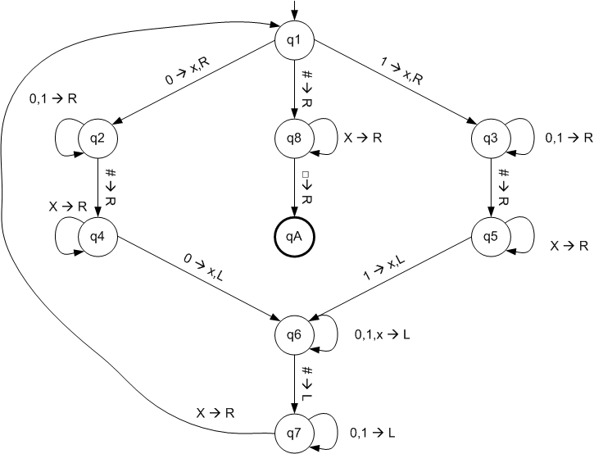
Example 2 TM State Diagram

Slide 13
Computation for 0110#0110
q₁0110#0110
xq₂110#0110
x1q₂10#0110
x11q₂0#0110
x110q₂#0110
x110#q₄0110
x110q₆#x110 x11q₇0#x110 x1q₇10#x110 xq₇110#x110 q₇x110#x110 xq₁110#x110 xxq₃10#x110 …

Slide 14
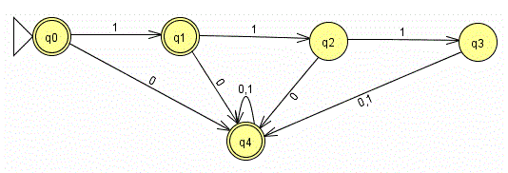
Simplified State Diagrams
Normally, we denote an accept state (called q_{A} or not) by a thick or double circle. (q₀, q₁, q₄ are accept states)
If there is no transition for a given input out of a given state, we reject.
So here we accept string 1100 or 00 or ε (empty string)
Accept the empty string since start state is an accept state
And we reject string 11 or 111

Slide 15
Recognizability and Decidability
There are three things that a T.M. can do when presented with an input string.
It can accept the string (transition to state q_{a}).
It can reject the string (transition to state q_{r}).
It can run forever (fail to ever reach either state).
The collection of strings that a T.M. M accepts is called the language of M or the language recognized by M. A language is Turing-recognizable if some T.M. recognizes it.
If some T.M. that recognizes a language always halts on a string, that language is decidable.

Slide 16
Recognizability & Decidability II
A T.M. that recognizes a language doesn’t always have to halt. Consider the language {w | w contains at least one zero}. A TM could read one’s “forever” if it doesn’t come to a zero. It would not halt. But since it accepts (halts) whenever it sees its first zero, it’s a recognizer.
It’s possible (sometimes) to write a T.M. that halts on all inputs. Such a T.M. is called a decider. A decider that recognizes some language is said to decide that language. A language is decidable if some T.M. decides it.

Slide 17
Regular Languages
A problem representable by a Finite State Machine (FSM) is decidable. Given an FSM and a set of inputs, it is always possible to determine if the FSM accepts the input.
In fact, a FSM is just a TM in which the tape always moves to the right.
Langauges expressible as FSMs are called “regular languages”.

Slide 18
Context-Free Languages
Modern programming languages are all represented by “context-free grammars” (CFGs).
Most of them are represented by a restricted form of such grammars.
Most problems dealing with these grammars are decidable.
The problem of determining whether a CFG accepts a string (whether a program is syntactically legal) is decidable.
But the problem of whether two programs are the same – whether or not they have the same output on all inputs – is undecidable in general.

Slide 19
Nondeterminism
The T.M. we’ve talked about is deterministic: At each point, there is one possible move.
Some T.M.s are non-deterministic. At some points, the machine may split into multiple machines, each performing a different transition.
Think of it like forking subprocesses in Linux or doing parallel computations.
Strangely enough, nondeterministic T.M.s are no more powerful than deterministic T.M.s.
Nondeterministic T.M. accepts if at least one thread accepts.

Slide 20
Nondeterminism and NP
The original motivation for calling the class of problems that can be verified in polynomial time “NP” is related to this.
A problem in NP is one that can be solved in polynomial time by a non-deterministic TM.
May take longer than polynomial time for a deterministic TM.

